Slide 1

Terrorist Activity Forecasting and Risk Assessment System
Jawahar Education Society’s
A. C.Patil College of Engineering, Kharghar
Department of Artificial Intelligence & Data Science
Name of Students Vedant Bhosale – 07 Ganesh Karli –32 Shraddha Ratambe - 54 Yash Shirsath - 74
Under the Guidance of
Prof. M.M. Deshpande
Date:-2 /11/2023

Slide 2
Contents
Introduction
Motivation
Literature review
Analysis of Review
Objectives
Scope
Problem Statement
Proposed System
Detail Design
Algorithm
Observations
Conclusion
References

Slide 3
Introduction
The global landscape in the 21st century is marked by complex and evolving security challenges, none more pressing than the threat of terrorism. Acts of terror have left a profound impact on societies, economies, and governments worldwide, underscoring the critical importance of effective counter-terrorism strategies. The "Terrorist Activity Forecasting and Risk Assessment System (TAFRAS)" represents a significant stride in addressing this ever-pressing challenge.
A Terrorist Activity Forecasting and Risk Assessment System (TAFRAS) is a system that uses a variety of data sources and analytical methods to forecast terrorist activity and assess the risk of terrorist attacks. TAFRAS systems can be used by law enforcement, intelligence agencies, and other stakeholders to prevent terrorist attacks, mitigate their impact, and respond to them more effectively.

Slide 4
Motivation
The motivation behind the TAFRAS project stems from the profound need to confront the relentless specter of terrorism. The indiscriminate violence inflicted by terrorist organizations has cost countless lives, disrupted global economies, and generated an atmosphere of fear. TAFRAS is a proactive response to these threats, designed to forecast potential terrorist activities and provide risk assessments to guide security and law enforcement agencies in making informed decisions. In a world where the line between security and vulnerability is often thin, TAFRAS seeks to strengthen security measures and mitigate the risks associated with terrorist acts.

Slide 5
Literature review
Predictive Modeling and Machine Learning: Many studies emphasize the use of predictive modeling and machine learning techniques in TAFRAS.
Geospatial analysis is instrumental in identifying geographic patterns of terrorist activities. Studies have used geographic information systems (GIS) to detect hotspots, vulnerable areas, and potential targets.
Network analysis techniques are applied to understand the structure of terrorist organizations and their communication patterns. Social network theory helps in identifying key figures and potential connections within terrorist groups. This information is crucial for risk assessment and targeting high-value individuals.

Slide 6
Analysis of Review
The review highlights the wide range of methodologies used in TAFRAS, from machine learning and data fusion to geospatial analysis and social network theory. This diversity reflects the complexity of the task at hand.
Geospatial analysis is a crucial component for identifying geographic patterns of terrorist activities. It aids in hotspot identification and informs decision-makers about potential target areas.
The development of early warning systems is a goal shared by many TAFRAS initiatives. These systems aim to provide timely alerts to authorities, enabling them to take preventive action. This proactive approach is seen as an effective means of mitigating the impact of terrorist incidents.

Slide 7
Objectives
The "Terrorist Activity Forecasting and Risk Assessment System (TAFRAS)" project sets out to address these complex challenges and achieve several objectives:
1. Advanced Data Analysis: - Develop a sophisticated system capable of collecting, processing, and analyzing vast amounts of historical data on terrorist activities, including geographical, temporal, and modus operandi information.
2. Pattern Recognition: - Employ cutting-edge machine learning algorithms to recognize patterns and trends within historical data. These patterns can be indicative of potential future attacks.

Slide 8
3. Predictive Modeling: - Build predictive models that can anticipate future terrorist activities based on the identified patterns. These models will enable the system to forecast the likelihood of attacks within specific regions and timeframes.
4. Risk Assessment: - Develop a risk assessment component that assigns risk scores to different geographic areas, allowing security agencies to allocate resources more efficiently and implement targeted security measures.
5. Enhanced Security Preparedness: - Provide decision-makers with actionable insights derived from data analysis, enabling them to make informed decisions and improve security preparedness.

Slide 9
6. Integration of Diverse Data Sources: - Aggregate data from various sources, including open-source intelligence, social media, and government databases, to provide a comprehensive view of the threat landscape.
7. Evaluation and Validation: - Rigorously evaluate the accuracy and effectiveness of the TAFRAS system through extensive testing and validation processes.
8. Future Expansion: - Lay the foundation for future expansion and development of the TAFRAS system, including the integration of more advanced machine learning techniques and emerging data sources.

Slide 10
SCOPE
TAFRAS involves the collection of data from various sources, such as open-source information, classified intelligence, social media, financial transactions, travel records, and geospatial data. The scope includes defining which data sources are relevant and how they are obtained.
TAFRAS employs predictive modeling and machine learning techniques to analyze historical data, identify patterns, and make forecasts regarding potential terrorist activities. The scope includes selecting appropriate algorithms and model development.

Slide 11
Problem Statement
The contemporary world faces an ever-escalating threat from terrorism. Acts of terrorism have disrupted societies, caused loss of life, and inflicted economic and emotional damage on a global scale. One of the central challenges is the unpredictability and complexity of these incidents, which often hampers the ability to prevent and mitigate such acts effectively. Traditional approaches to security often fall short when dealing with the dynamic and evolving nature of terrorist activities. There is an urgent need for an advanced system that can anticipate and assess potential terrorist threats with a high degree of accuracy, providing valuable insights to aid security and law enforcement

Slide 12
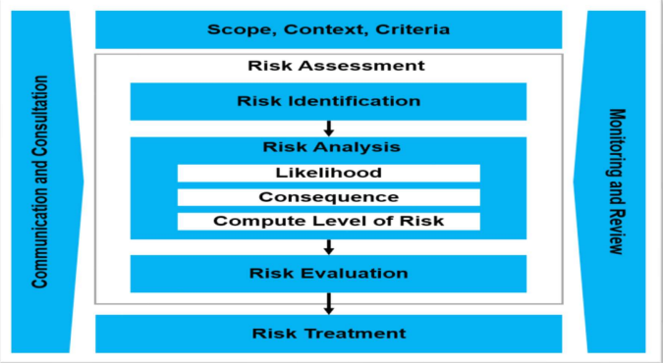
Proposed System

Slide 13
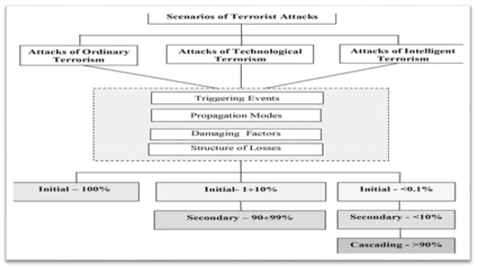
Fig - Algorithm and Process Design

Slide 14
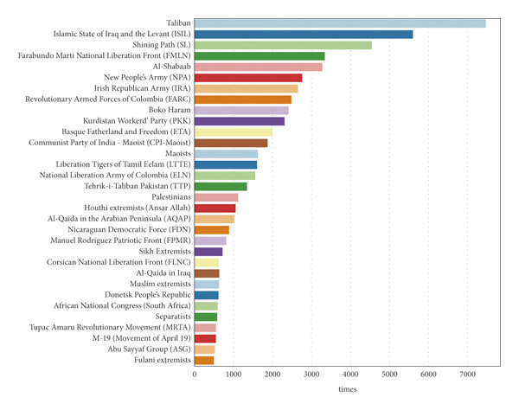
Observations
TAFRAS, the Terrorist Activity Forecasting and Risk Assessment System, represents a critical response to the dynamic threat of terrorism, integrating advanced technology and data analysis to enable proactive, data-driven decision-making while addressing significant ethical and international cooperation challenges

Slide 15
Conclusion
In conclusion, the development and implementation of a TAFRAS represent a critical response to the dynamic and adaptive nature of terrorist threats in the modern world.
TAFRAS integrates advanced technologies, data analytics, and predictive modeling to enable proactive, data-driven decision-making in the field of counterterrorism. The system's scope includes addressing complex challenges, such as ethical considerations, resource allocation, and international collaboration.
The successful development and utilization of TAFRAS are critical for staying ahead of emerging threats, preventing terrorist incidents, and minimizing their impact.

Slide 16
References
https://www.start.umd.edu/gtd
https://www.start.umd.edu/research-projects/global-terrorism-database-gtd
https://www.rand.org/nsrd/projects/terrorism-incidents.html

Slide 17
Thank You

